Slide 1

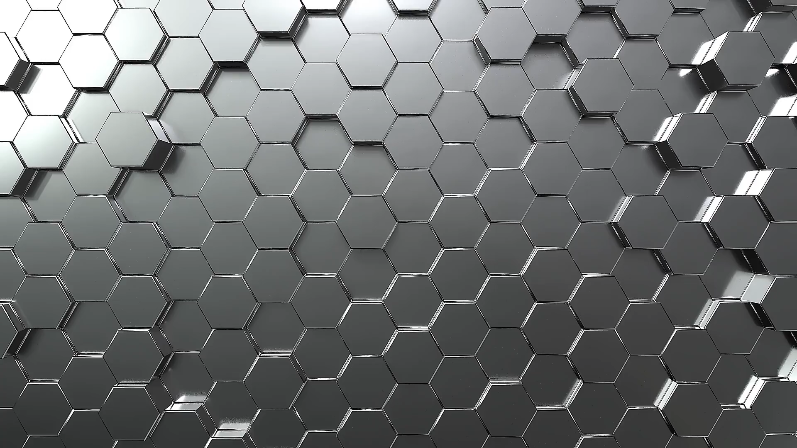

WELCOME
IRCL 2nd Annual Build Workshop Presented by:

Slide 2
Who Are We?
Steven Jack – IRCL Board Member, BoomBox Robotics Owner
David Ultis – IRCL Chairman, Citizen Science Workshop Owner
Danielle Sims – IRCL Board Member, BoomBox Robotics Owner
Dan – IRCL Board Member

Slide 3
What is the Plastic Antweight class?
Robots must weigh no more than 1lb (454g)
The spirit of this class is to create an accessible and affordable class that encourages experimentation and rapid iteration by utilizing 3D printing.
Commercial Off The Shelf parts can be made from any material. This includes components such as motors, electronics, axles, bushings, bearings, fasteners, and adhesives
Frames, weapons and other custom parts may only be made from PLA, PLA+, PET, PETG, ABS, or ASA and must be FDM/FFF 3D printed.

